Slide 1

Alzheimer’s Classification and Progress Detection using CNN
Kishan Shetty
MSc Data Science
University of Bristol

Slide 2
ABOUT the Project
This work focuses on working with the medical data of people suffering from Alzheimer’s. We aim to use the MRI scans of the brain and build a neural network that analyses these scans and makes the task of predicting the stage of the disease and seeing the progression of the same easily and quickly.

Slide 3
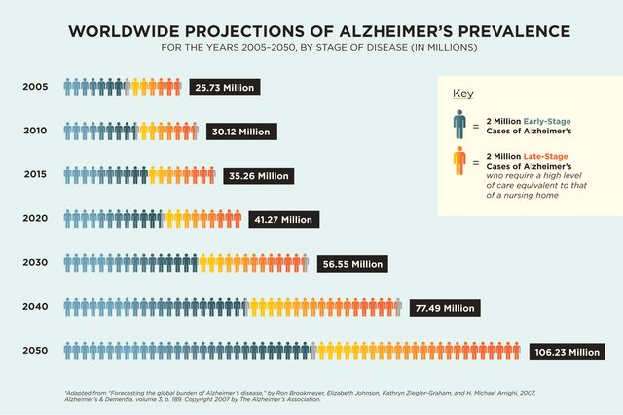
Significance
Motivation
Alzheimer’s has no discovered cure yet and hence patients only get worse. If it were possible to detect the onset of the disease in a patient sooner, then medication can be started immediately to avoid severe damage.
Data source
Alzheimer's Disease Neuroimaging Initiative
(ADNI)
Related work
Much research has been done and continues to help the society in early detection of the disease.
Stages
CN, EMCI MCI, LMCI and AD

Slide 4
Aim #1: CNN Model to Predict Mono-Stage

Slide 5
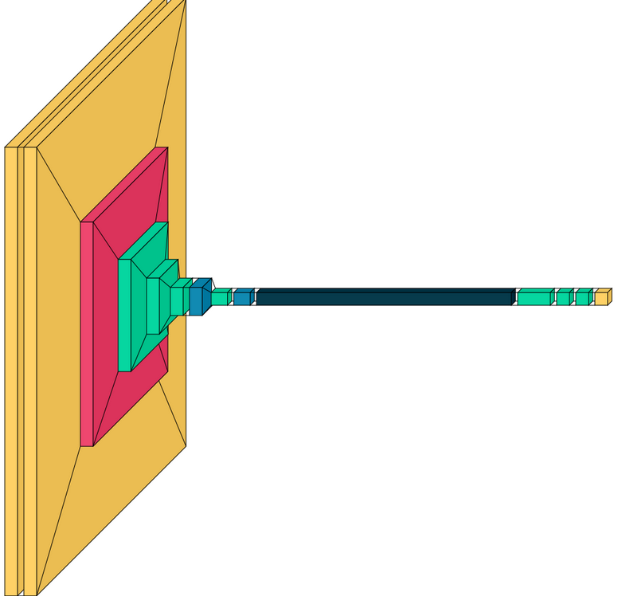
Goal
To construct a CNN model that would take MRI scans as input and analyze it to determine which 1 of the 5 stages the scan belongs to.
Data Split
After augmentation, we had 2400 samples belonging to 5 classes.
Training: 1600
Validation: 400
Testing: 400
Pre-processing
Cropping images to 176x176
Image augmentation
Resampling
Architecture
The model has Convolutional layers, Pooling layer, Dropout layer, Flattening layer and a Fully connected layer with ReLu and Softmax activation functions.
The model was trained for 100 epochs with learning rate of 0.05 and Adam optimizer.

Slide 6
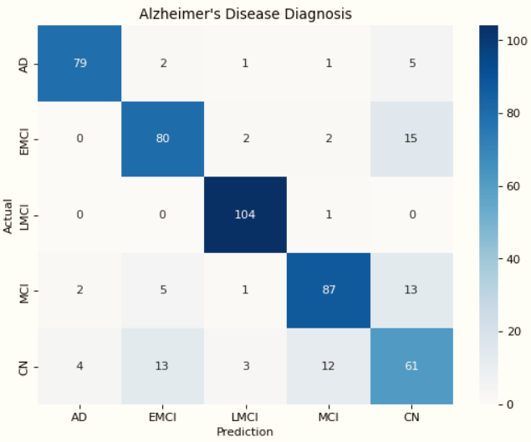
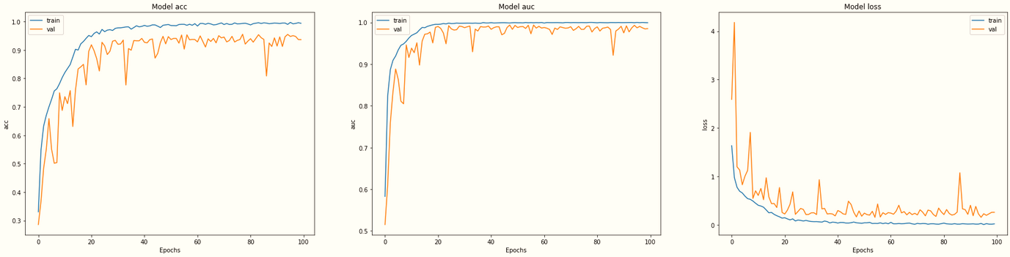
Evaluation
Performance
 | Precision | Recall | F1 Score | Support
AD | 0.93 | 0.9 | 0.91 | 88
EMCI | 0.81 | 0.81 | 0.8 | 99
LMCI | 0.94 | 0.99 | 0.96 | 105
MCI | 0.85 | 0.83 | 0.83 | 109
CN | 0.79 | 0.81 | 0.82 | 93
Set | Score
Training | 0.99
Validation | 0.94
Testing | 0.93

Slide 7
Aim #2: CNN Model to Predict Multi-Stage

Slide 8
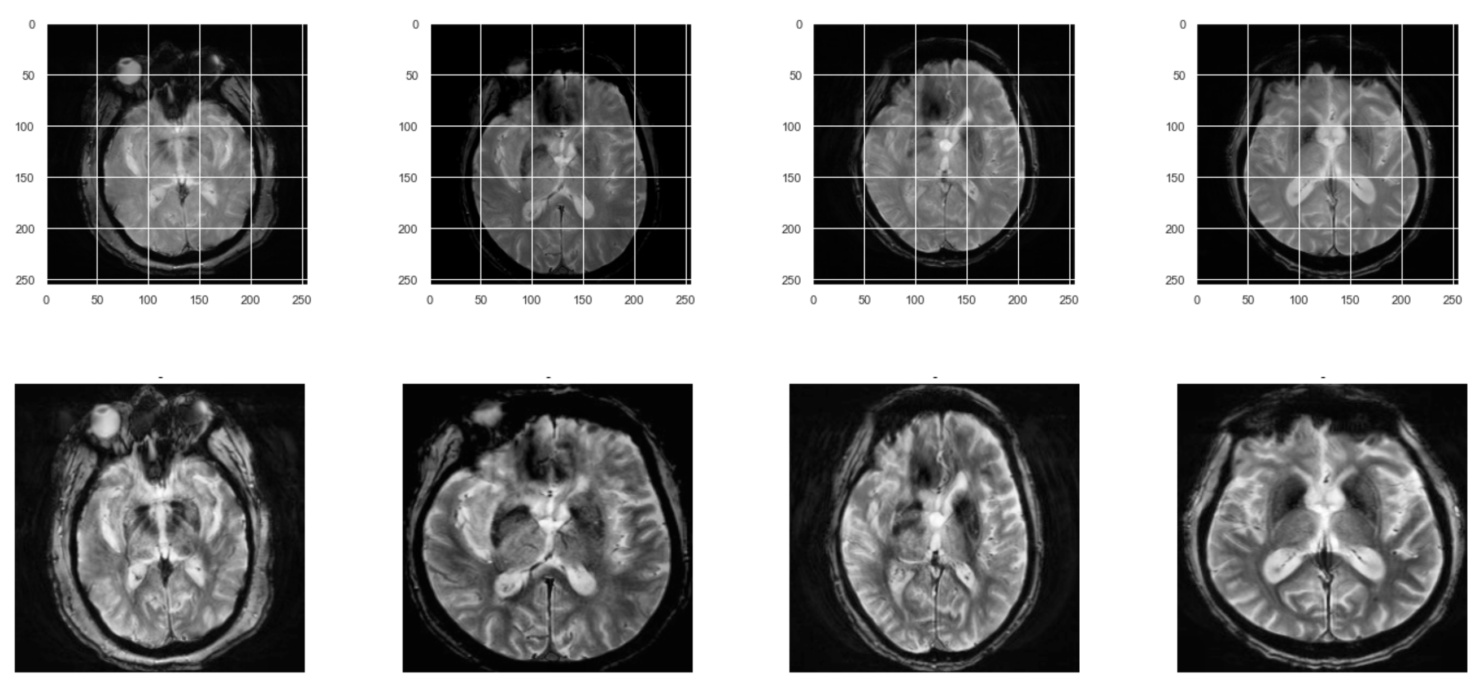
Goal
To build a model that can take MRI scans and .csv files as input and train the model so that it can predict a multi-stage analysis on test samples.
Data Split
There are 2400 samples after the augmentation and pre processing steps belonging to 5 classes.
Training: 1600
Validation: 400
Testing: 400
Pre-processing
Image cropping to 224x224, Image Augmentation and Resampling
Architecture
We used a DenseNet121 model which is trained on EfficientNet version of CNN. We created a multi-label representation for every training. Eg: Representing (1,1,1,0,0) for 3rd stage instead of (0,0,1,0,0).
Model was trained for 50 epochs with a learning rate of 0.0005

Slide 9
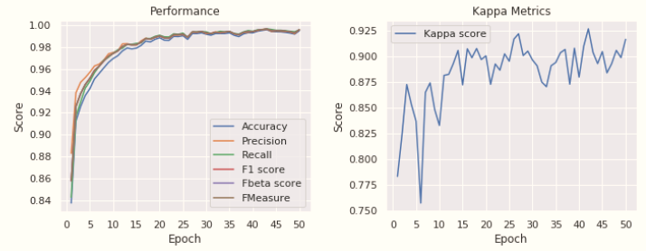
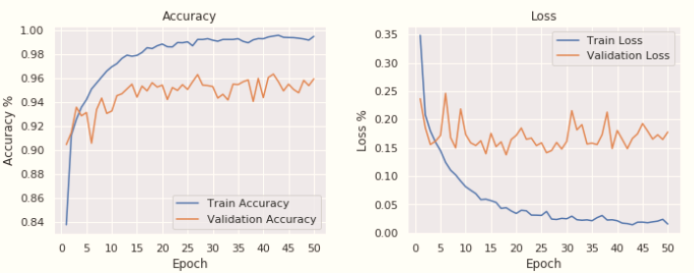
Evaluation
Performance
 | Diagnosis | 1 | 2 | 3 | 4 | 5
Sample 1 | 3 | 1.0 | 0.92 | 0.69 | 0.0.09 | 0.05
Sample 2 | 4 | 1.0 | 0.95 | 0.93 | 0.73 | 0.05
Sample 3 | 2 | 1.0 | 0.77 | 0.12 | 0.05 | 0.01
Set | Score
Training | 0.99
Validation | 0.96

Slide 10
Conclusion
After dedicating a couple of months on this work we were able to achieve the goals that we initially set out to.
Out aim to achiveve a model that can successfully predict the mono stage of the Alzheimer;s dsease was successfully implemented which produced some good result having an accuracy of 93% while having a higher precision and recall scores as well.
The objective to further build a model that can manage to perform a ranked multi stage prediction of the disease was also achieved where the model can show us the progression og the disease in a test sample with accuracy of 96% while having great precision, recall, f1 score and kappa score as well.
The data that was used for this task was downloaded from ADNI website.

Slide 11
Future Work
There definitely is a lot of scopes to improve the work and come up with an elegant model that is more advanced in detecting the disease and not to forget more intelligent in doing so. This work does not consider the history of the patient's diagnosis. As an extension what can be done is developing a model that takes into account the previous diagnosis of the AD into consideration and the latest MRI scan of the patient as input. Once the model makes a wide probabilistic prediction across all the classes based on its training, the predicted stage and the previously diagnosed stage can be compared. If the predicted stage is advanced then it is acceptable but if not, then the model must revert and select the second-best prediction and compare it with the previous diagnosis. The advantage of this model is that this can be customized to be patient-specific and save a lot of time for patients and medical professionals.

Slide 12
THANK YOU

